Slide 1
PERSONAL DATABASE
PRESENTATION BY: SUMIT HAJONG
ROLL NO- 26
MCA 4TH SEMESTER

Slide 2
What is a personal Database ?
Every year, you add more information to your Documents folder, and every year it’s harder to find the data that you’ve saved.
The Windows file system has some real shortcomings
Searching is not easy
One file per folder.
The file system is not friendly to small things.
The file system is not extensible.

Slide 3
What is a personal Database ?
Personal databases are typically small database management systems designed to be used by only one person to organize information
stores all the important data in a single compact and portable file
its own ways of organizing and accessing information
Eg- Treeprojects, Bento, Tap forms HD etc.

Slide 4
Personal database
TreeProjects personal database defines several types of items.
“file” item stores regular files .Import files from the hard drive.
text items, enable quick and simple note-taking.
“Web page” allow to capture, store and review web pages
Email message” items store and display important electronic letters.
“reminder” items prevent you from forgetting things.

Slide 5
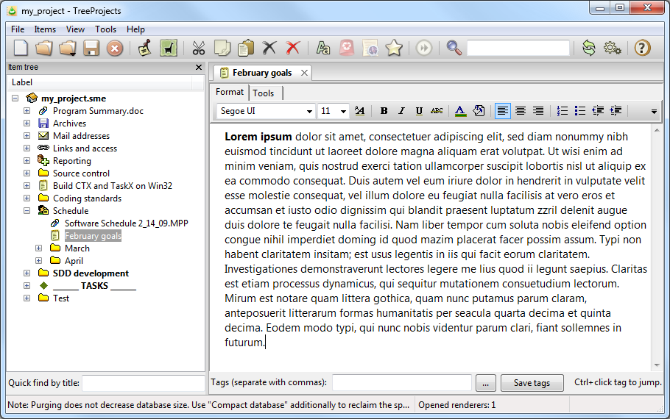

Slide 6
Database tree view structure
The tree view resembles the directory tree of Windows Explore.
firstly, any item can be the “parent” of any item, so the tree structure is truly freeform
Secondly, the order of items is defined by the user and is not alphabetical
And thirdly, one item can appear in multiple locations of the tree by reference.

Slide 7
8 built-in types of information items
text – for brief unformatted notes.
formatted text – for formatted text documents that support images and tables.
webpage – for storing webpages complete with images and styles.
file – for storing and in-place editing of arbitrary file attachments.

Slide 8
8 built-in types of information items
email message – for storing and viewing electronic letters.
folder – for visual organizing of your data.
reference – for accessing an information item from multiple branches.
reminder – for configuring one-time or periodical, timezone-dependent or timezone-independent alerts.

Slide 9
powerful search capabilities
transparent text indexing and instant full text search;
search in the contents of stored files like Office or PDF files;
search in deleted items or item revisions;
search in item content, item titles, tags and other attributes;
users can assign tags to any item in the database

Slide 10
powerful search capabilities
wildcard search to find morphological forms of words;
support for boolean operators (OR, AND, NOT) in text search queries

Slide 11
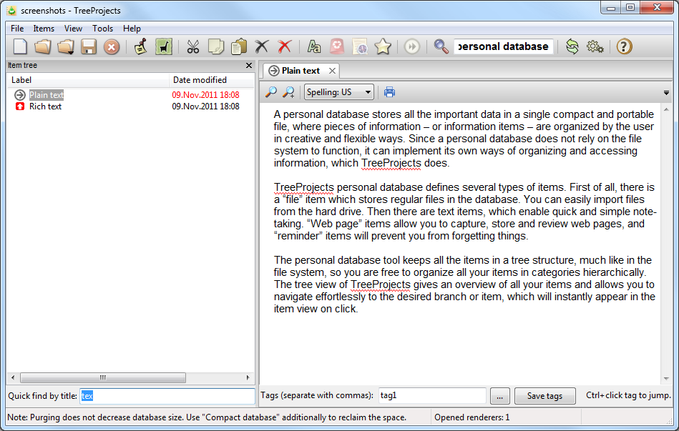

Slide 12
Exporting information from your personal database file
TreeProjects keeps all the data in a single file, one cannot access the data without the application.
The personal database tool can export all your items to the hard drive, preserving the content and the relations of the items in terms of files and folders.

Slide 13
References
http://personaldatabase.org/how-it-works
https://readwrite.com/2011/06/03/persona-database-apps-ipad/
https://support.office.com/en-us/article/Examples-of-wildcard-characters-939e153f-bd30-47e4-a763-61897c87b3f4

Slide 14
THANK YOU !!!

